Slide 1

Improvi
Go, change the world
RV College of
Engineering
Unit 1 (Introduction to Database Systems)
Original Content: Ramez Elmasri and Shamkant B. Navathe
Dr. Poonam Ghuli
Associate Professor, Department of CSE
RV College of Engineering, Bengaluru - 59

Slide 2

Contents
Go, change the world
RV College of
Engineering
Basic Definitions
Typical DBMS Functionality
Example of a Database (UNIVERSITY)
Main Characteristics of the Database Approach
Database Users
Data Models
Schemas and Instances
Three-schema Architecture and Data Independence
Database Languages and Interfaces
The Database System Environment.

Slide 3
Basic Definitions
Go, change the world
RV College of
Engineering
Database:
A collection of related data.
Data:
Known facts that can be recorded and have an implicit meaning.
Mini-world:
Some part of the real world about which data is stored in a database. For example, student grades and transcripts at a university.
Database Management System (DBMS):
A software package/ system to facilitate the creation and maintenance of a computerized database.

Slide 4
Basic Definitions
Go, change the world
RV College of
Engineering
Database:
A collection of related data that have some implicit meaning.
Database Management System (DBMS):
A software package/ system to facilitate the creation and maintenance of a computerized database.
The DBMS is a general-purpose software system that facilitates the processes of defining, constructing, manipulating, and sharing databases among various users and applications.
Database System:
The DBMS software together with the data itself. Sometimes, the applications are also included.

Slide 5
Typical DBMS Functionality
Go, change the world
RV College of
Engineering
Defining a particular database in terms of its data types, structures, and constraints of the data stored in DB.
The database definition or descriptive information is also stored by the DBMS in the form of a database catalog or dictionary; it is called meta-data
Constructing the database is the process of storing the database contents on a secondary storage medium
Manipulating the database:
Retrieval: Querying, generating reports
Modification: Insertions, deletions and updates to its content
Accessing the database through Web applications
Processing and Sharing to allow set of concurrent users to access data throguh application programs – yet, keeping all data valid and consistent

Slide 6
Typical DBMS Functionality
Go, change the world
RV College of
Engineering
Other features:
Protection or Security measures to prevent unauthorized access
Presentation and Visualization of data
Maintaining the database and associated programs over the lifetime of the database application
Called database, software, and system maintenance

Slide 7
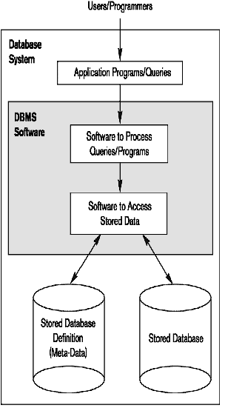
Simplified database system environment
Go, change the world
RV College of
Engineering

Slide 8
Typical Design Process
Go, change the world
RV College of
Engineering
Database Application
Requirement Collections
Requirement Collections
Design DB with the help of Conceptual Model (ER model)
Build a large Table consisting of all the entities, attributes
Design using Implementation Data model (Mapping of ER to Relational model )
Use Normal Forms to satisfy some conditions
Use Normal Forms to satisfy some conditions
Application Programs

Slide 9
Example of a Database (with a Conceptual Data Model)
Go, change the world
RV College of
Engineering
Mini-world for the example:
Part of a UNIVERSITY environment.
Some mini-world entities:
STUDENTs
COURSEs
SECTIONs
(academic) DEPARTMENTs
INSTRUCTORs

Slide 10
Example of a Database (with a Conceptual Data Model)
Go, change the world
RV College of
Engineering
Some mini-world relationships:
STUDENTs belong to SECTIONs
COURSEs have prerequisite COURSEs
INSTRUCTORs teach SECTIONs
COURSEs are offered by DEPARTMENTs
STUDENTs major in DEPARTMENTs

Slide 11
Main Characteristics of the Database Approach
Go, change the world
RV College of
Engineering
Self-describing nature of a database system:
A DBMS catalog stores the description of a particular database (e.g. data structures, types, and constraints)
The description is called meta-data.
This allows the DBMS software to work with different database applications such as University DB, Banking DB or Company DB.
Insulation between programs and data:
Called program-data independence.
Allows changing data structures and storage organization without having to change the DBMS access programs.

Slide 12
Main Characteristics of the Database Approach
Go, change the world
RV College of
Engineering
Data Abstraction:
The characteristic that allows program-data independence and program-operation independence
Program-operation independence
User application programs can operate on the data by invoking operations through their names and arguments, regardless of how the operations are implemented
A data model is used to hide storage details and present the users with a conceptual view of the database.
Relational model hides how the data is stored and how the operations are implemented. DB is represented in terms of entities, attributes and relationships among entities that is understood by most users.
Programs refer to the data model constructs rather than data storage details
Support of multiple views of the data:
Each user may see a different view of the database, which describes only the data of interest to that user.

Slide 13
Main Characteristics of the Database Approach
Go, change the world
RV College of
Engineering
Sharing of data and multi-user transaction processing:
Allowing a set of concurrent users to retrieve from the DB and to update the database.
A Transaction is
An execution program or process that includes one or more database accesses, such as reading or updating.
Supposed to execute a logically correct database access, executed in its entirety without interference from other transactions.

Slide 14
Main Characteristics of the Database Approach
Go, change the world
RV College of
Engineering
A DBMS must enforce following transaction properties
Isolation
Each transaction appears to execute in isolation from other transactions.
Atomicity
Either all the database operations in a transaction are executed or none are.
Concurrency control within the DBMS guarantees that each transaction is correctly executed or aborted
Recovery subsystem ensures each completed transaction has its effect permanently recorded in the database
OLTP (Online Transaction Processing) is a major part of database applications. This allows hundreds of concurrent transactions to execute per second.

Slide 15
Database Users
Go, change the world
RV College of
Engineering
Users may be divided into
Those who actually use and control the database content, and those who design, develop and maintain database applications (called “Actors on the Scene”), and
Those who design and develop the DBMS software and related tools, and the computer systems operators (called “Workers Behind the Scene”).

Slide 16
Database Users
Go, change the world
RV College of
Engineering
Actors on the scene
Database Administrators:
Database Administrator (DBA) is a person/team who defines the schema
The DBA will then create a new account id and password for the user if he/she need to access the data base.
DBA is also responsible for providing security to the data base and he allows only the authorized users to access/modify the data base.
DBA also monitors the recovery and back up and provide technical support.
The DBA has a DBA account in the DBMS which called a system or super user account.
DBA repairs damage caused due to hardware and/or software failures.

Slide 17
Database Users
Go, change the world
RV College of
Engineering
Database Designers:
Responsible to define the content, the structure, the constraints, and functions or transactions against the database. They must communicate with the end-users and understand their needs.
He/she controls what data must be stored and how the data items to be related.
System Analysts and Application Programmers (Software Engineers)
System Analyst is a user who analyzes the requirements of parametric end users. They check whether all the requirements of end users are satisfied.
Application Programmers are the computer professionals who write the code for the application programs. These programs could be written in Programming languages such as Visual Basic, Developer, C, FORTRAN, COBOL etc.
Application program helps the end user to retrieve, create and modify the data in DB
They interact with DBMS through DML (Data manipulation language) queries and these queries are embedded

Slide 18
Categories of End-users
Go, change the world
RV College of
Engineering
End-users: They use the data for queries, reports and some of them update the database content. End-users can be categorized into:
Casual:
access database occasionally when needed. They use a sophisticated database query language basically to specify their request
they are typically middle or high level managers or other occasional browsers.
Naïve or Parametric:
they do not have any knowledge about database.
Their task is to just use the developed application and get the desired results.
Examples are bank customers, bank-tellers or reservation clerks, who do this activity for an entire shift of operations.

Slide 19
Categories of End-users
Go, change the world
RV College of
Engineering
End-users: They use the data for queries, reports and some of them update the database content. End-users can be categorized into:
Sophisticated:
These include business analysts, scientists, engineers, others thoroughly familiar with the system capabilities.
These users access data by entering different queries from the terminal end. They do not write programs but they can interact with the system by writing queries.
Some of them thoroughly familiarize themselves with the facilities of the DBMS in order to implement their own applications to meet their complex requirements.
Stand-alone:
Mostly maintain personal databases using ready-to-use software packaged applications.
Another example is a user that maintains an address book

Slide 20
Workers behind the Scene
Go, change the world
RV College of
Engineering
DBMS System Designers and Implementers
Design and implement the DBMS modules and interfaces as a software package
It includes modules for implementing the catalog, query language processing, interface processing, accessing and buffering data, controlling concurrency, and handling data recovery and security.
Interface with system software, such as the operating system and compilers for various programming languages.
Tool Developers
Design and implement tools – the software packages that facilitate database modeling and design, database system design, and improved performance. Tools are optional packages that are often purchased separately. They include packages for database design, performance monitoring, natural language or graphical interfaces, prototyping, simulation and test data generation.
Operators and Maintenance Personnel
Responsible for the actual running and maintenance of the hardware and software environment for the database system.

Slide 21
Data Models
Go, change the world
RV College of
Engineering
Data Abstraction
Suppression of details of data organization and storage and the highlighting of the essential features for an improved understanding of data
Data Model:
A collection of concepts to describe the structure of a database, the operations for manipulating these structures, and certain constraints that the database should obey.
It provides necessary means to achieve data abstraction
Data Model Structure and Constraints:
Data Model Structure is a collection of DB Constructs.
DB Constructs typically include elements (and their data types) as well as groups of elements (e.g. entity, record, table), and relationships among such groups
Constraints specify some restrictions on valid data; these constraints must be enforced at all times.

Slide 22
Data Models
Go, change the world
RV College of
Engineering
Data Model Operations:
These operations are used for specifying database retrievals and updates by referring to the constructs of the data model.
Operations on the data model may include basic model operations (e.g. generic insert, delete, update) and user-defined operations (e.g. compute_student_gpa, update_inventory)

Slide 23
Categories of Data Models
Go, change the world
RV College of
Engineering
Data models are categorized according to the types of concepts they use to describe the database structure.
Conceptual (high-level, semantic) data models:
Provide concepts that are close to the way many users perceive data.
(Also called entity-based or object-based data models.)
Conceptual data models use concepts such as entities, attributes, and relationships.
Physical (low-level, internal) data models:
Provide concepts that describe details of how data is stored in the computer by representing information such as record formats, record orderings, and access paths.
An access path is a search structure that makes the search for particular database records efficient, such as indexing or hashing.
These are usually specified in an ad-hoc manner through DBMS design and administration manuals.

Slide 24
Categories of Data Models
Go, change the world
RV College of
Engineering
Implementation (representational) data models:
Provide concepts that fall between the above two, used by many commercial DBMS implementations (e.g. relational data models used in many commercial systems).
Representational data models represent data by using record structures and hence are sometimes called record-based data models.
Self Describing Data Models:
The data storage in systems based on these models combines the description of the data with the data values themselves.
These models include XML as well as many of the key-value stores and NOSQL systems that were recently created for managing big data.

Slide 25
Database Schema
Go, change the world
RV College of
Engineering
Database Schema
The description of a database.
Includes descriptions of the database structure, data types, and the constraints on the database.
Schema Diagram
An illustrative display of (most aspects of) a database schema.
Schema Construct
A component of the schema or an object within the schema, e.g., STUDENT, COURSE.

Slide 26
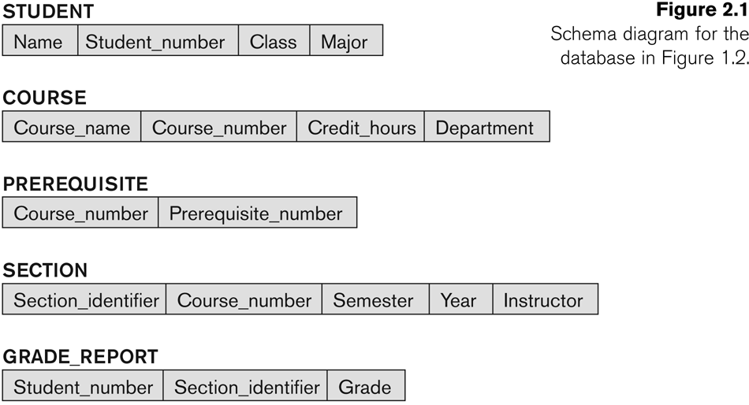
Example of a Database Schema
Go, change the world
RV College of
Engineering

Slide 27
Database State
Go, change the world
RV College of
Engineering
Database State
The actual data stored in a database at a particular moment in time. This includes the collection of all the data in the database.
Also called database instance (or occurrence or snapshot).
The term instance is also applied to individual database components, e.g. record instance, table instance, entity instance
Refers to the content of a database at a moment in time.
Initial Database State
Refers to the database state when it is initially loaded into the system.
Valid State
A state that satisfies the structure and constraints of the database.

Slide 28
DB Schema v/s DB State
Go, change the world
RV College of
Engineering
Distinction
The database schema changes very infrequently.
The database state changes every time the database is updated.
Schema is also called intension.
State is also called extension.

Slide 29
Three-Schema Architecture
Go, change the world
RV College of
Engineering
Proposed to support DBMS characteristics of:
Program-data independence.
Support of multiple views of the data.
use of a catalog to store the database description (schema) so as to make it self-describing
Its goal is to separate the user applications and the physical database.
Not explicitly used in commercial DBMS products, but has been useful in explaining database system organization/ DB System Architecture

Slide 30
The Three-Schema Architecture
Go, change the world
RV College of
Engineering
Defines DBMS schemas at three levels:
Internal schema at the internal level to describe physical storage structures and access paths (e.g indexes).
Typically uses a physical data model.
Conceptual schema at the conceptual level to describe the structure and constraints for the whole database for a community of users.
It describes entities, data types, relationships, user operations and constraints.
Uses an implementation data model.
External schemas at the external level (or view level) to describe the various user views.
Usually uses the same data model as the conceptual schema.
Each external schema describes the part of the database that a particular user group is interested in and hides the rest of the database from that user group.

Slide 31
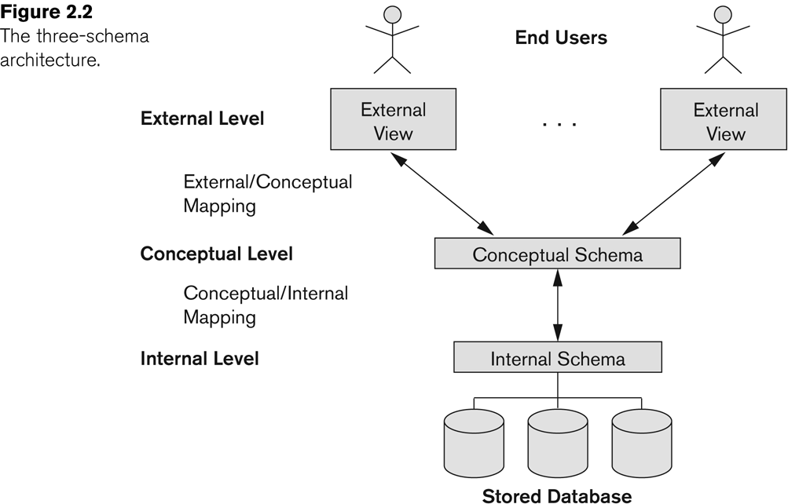
The Three-Schema Architecture
Go, change the world
RV College of
Engineering

Slide 32
Data Independence
Go, change the world
RV College of
Engineering
Logical Data Independence:
The capacity to change the conceptual schema without having to change the external schemas and their associated application programs.
Physical Data Independence:
The capacity to change the internal schema without having to change the conceptual schema.
For example, the internal schema may be changed when certain file structures are reorganized or new indexes are created to improve database performance

Slide 33
Examples of changes under Physical Data Independence
Go, change the world
RV College of
Engineering
Due to Physical data independence, any of the below change will not affect the conceptual layer.
Using a new storage device like Hard Drive or Magnetic Tapes
Modifying the file organization technique in the Database
Switching to different data structures.
Changing the access method.
Modifying indexes.
Changes to compression techniques or hashing algorithms.
Change of Location of Database from say C drive to D Drive

Slide 34
Examples of changes under Logical Data Independence
Go, change the world
RV College of
Engineering
change the conceptual schema to expand the database (by adding a
record type or data item),
to change constraints (add or delete constraints), or
to reduce the database (by removing a record type or data item).
In the last case, external schemas that refer only to the remaining data should not be affected.

Slide 35
Data Independence
Go, change the world
RV College of
Engineering
When a schema at a lower level is changed, only the mappings between this schema and higher-level schemas need to be changed in a DBMS that fully supports data independence.
The higher-level schemas themselves are unchanged.
Hence, the application programs need not be changed since they refer to the external schemas.
Logical data independence is more difficult to achieve than physical data independence, since application programs are heavily dependent on the logical structure of the data that they access.

Slide 36
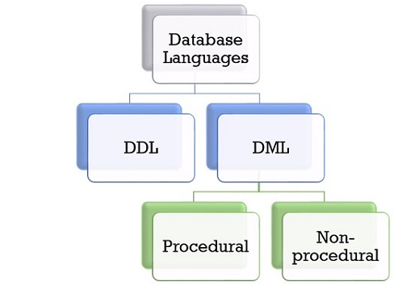
DBMS Languages
Go, change the world
RV College of
Engineering

Slide 37
DBMS Languages
Go, change the world
RV College of
Engineering
Data Definition Language (DDL)
Data Manipulation Language (DML)
High-Level or Non-procedural Languages: These include the relational language SQL
May be used in a standalone way or may be embedded in a programming language
Low Level or Procedural Languages:
These must be embedded in a programming language

Slide 38
DBMS Languages
Go, change the world
RV College of
Engineering
Data Definition Language (DDL):
Used by the DBA and database designers to specify the conceptual schema of a database.
In many DBMSs, the DDL is also used to define internal and external schemas (views).
In some DBMSs, separate storage definition language (SDL) and view definition language (VDL) are used to define internal and external schemas respectively.
But today, most of the relational DBMS do not use SDL for specifying the physical schema. Instead, the physical schema is defined using the combination of functions and parameters which allows DBA to map data to the storage.
But today, most of the relational DBMS do not use VDL for specifying the external schema. But today in most of the DBMSs, DDL performs the role of VDL.

Slide 39
DBMS Languages
Go, change the world
RV College of
Engineering
Data Manipulation Language (DML):
Data Manipulation Language has a set of statements that allows users to access and manipulate the data in the database.
Using DML statements user can retrieve, insert, delete or modify the information in the database.
DML commands (data sublanguage) can be embedded in a general-purpose programming language (host language), such as COBOL, C, C++, or Java.
A library of functions can also be provided to access the DBMS from a programming language
Alternatively, stand-alone DML commands can be applied directly (called a query language).

Slide 40
Types of DML
Go, change the world
RV College of
Engineering
Non-procedural DML Language:
For example, the SQL relational language
Are “set”-oriented and specify what data to retrieve without specifying how to retrieve it. Many records can be retrieved in one DML statement
Also called declarative languages.
Procedural Language DML:
Procedural DML is used to tell the system what data to be retrieved and how to retrieve the data. Procedural DML is embedded into a high-level programming language.
Retrieve data one record-at-a-time;
Constructs such as looping are needed to retrieve multiple records, along with positioning pointers.

Slide 41
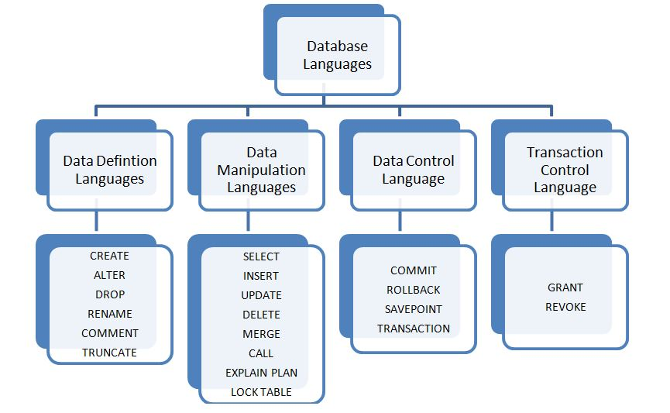
DBMS Languages
Go, change the world
RV College of
Engineering

Slide 42
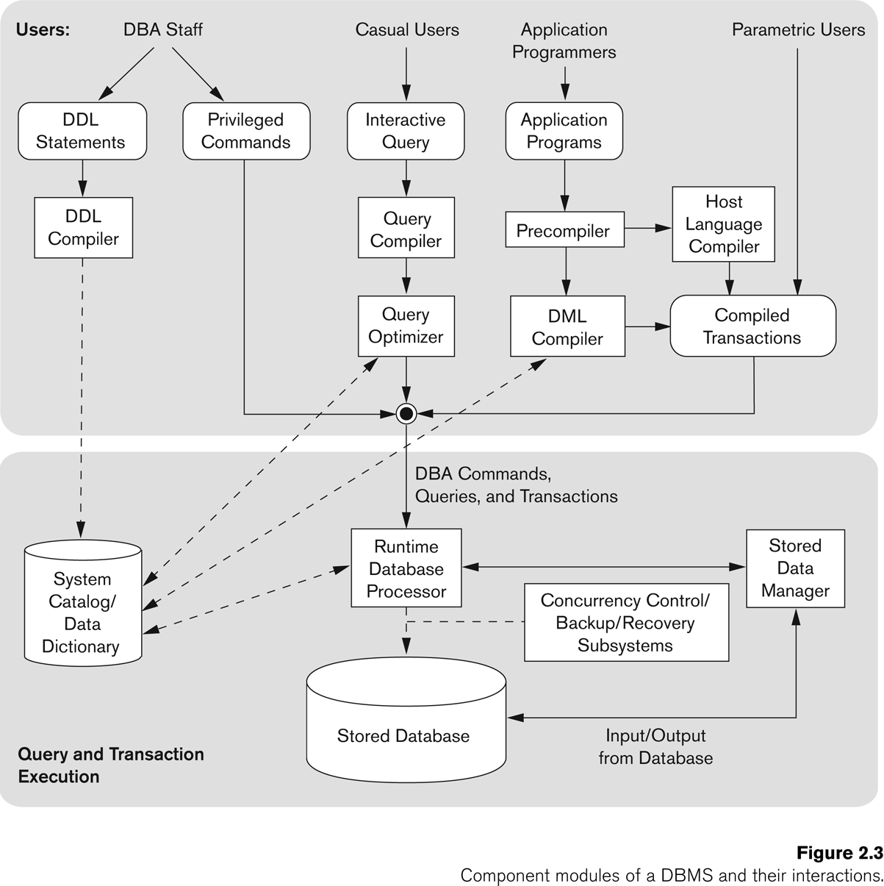
Typical DBMS Component Modules
Go, change the world
RV College of
Engineering

Slide 43
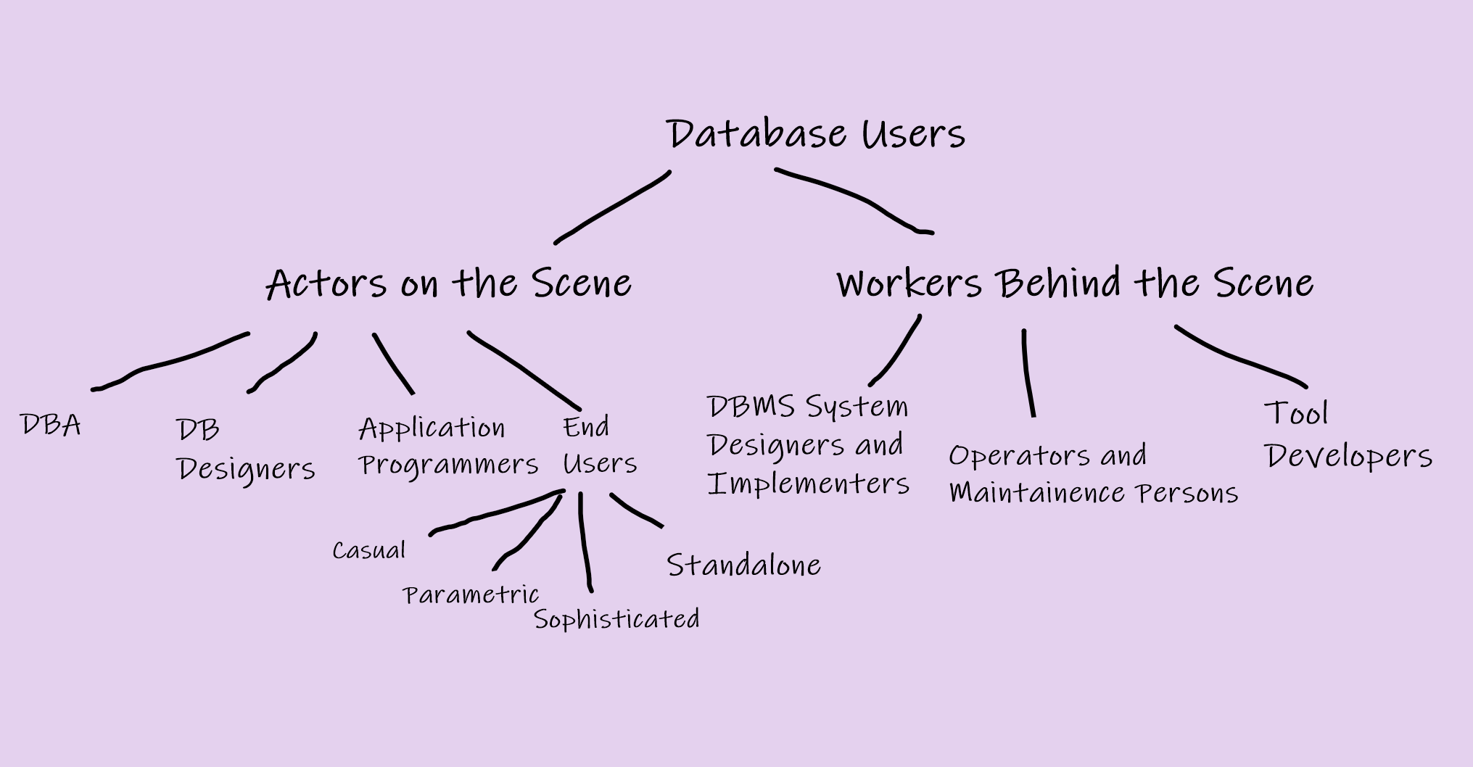
Categories of Database Users
Go, change the world
RV College of
Engineering

Slide 44
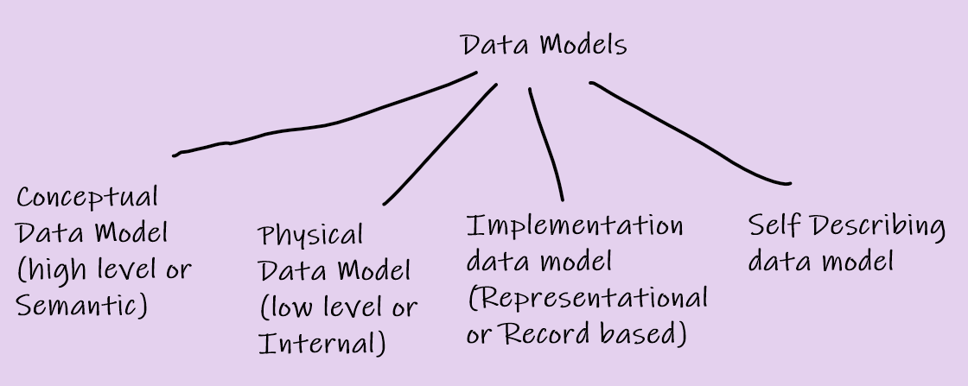
Categories of Data Models
Go, change the world
RV College of
Engineering

Slide 45
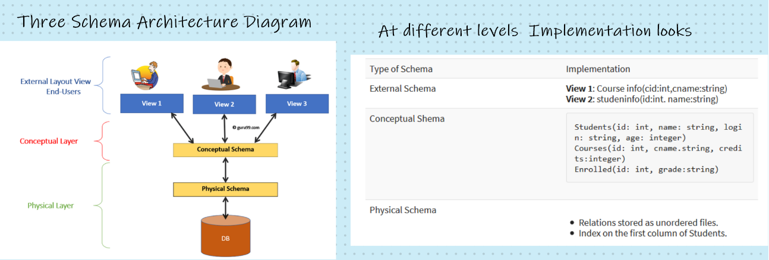
Analogy of Three Schema Architecture
Go, change the world
RV College of
Engineering

Slide 46
Go, change the world
RV College of
Engineering
Thank YOU

Slide 47
Link to all Classes for this Chapter
Go, change the world
RV College of
Engineering
Class 1
https://drive.google.com/open?id=17CasZUzPVP3Kpzca7oN81OXhFz2VxQNf&authuser=0
Class 2
https://drive.google.com/open?id=18A-BUjnswJO-urKrn93VHLD5lLq8Ss2S&authuser=0
Class 3
https://drive.google.com/open?id=1iwSdzr84Cca81numwRSzHpq83Oh91wxH&authuser=0
Class 4
https://drive.google.com/open?id=194NjrJ5gnOjy9_UCrgZ5Q9AfOFs9AjIO&authuser=0
Class 5
https://drive.google.com/open?id=1_m3QFv9kwCxuU9HxIixlOB34VLzi8olH&authuser=0

